Slide 1
TRAINING MODELS (cont.)
Main reference: Chapter 4 of Géron, A. (2019). Hands-on machine learning with Scikit-Learn, Keras, and TensorFlow.

Slide 2
Problems of Gradient descent

Slide 3
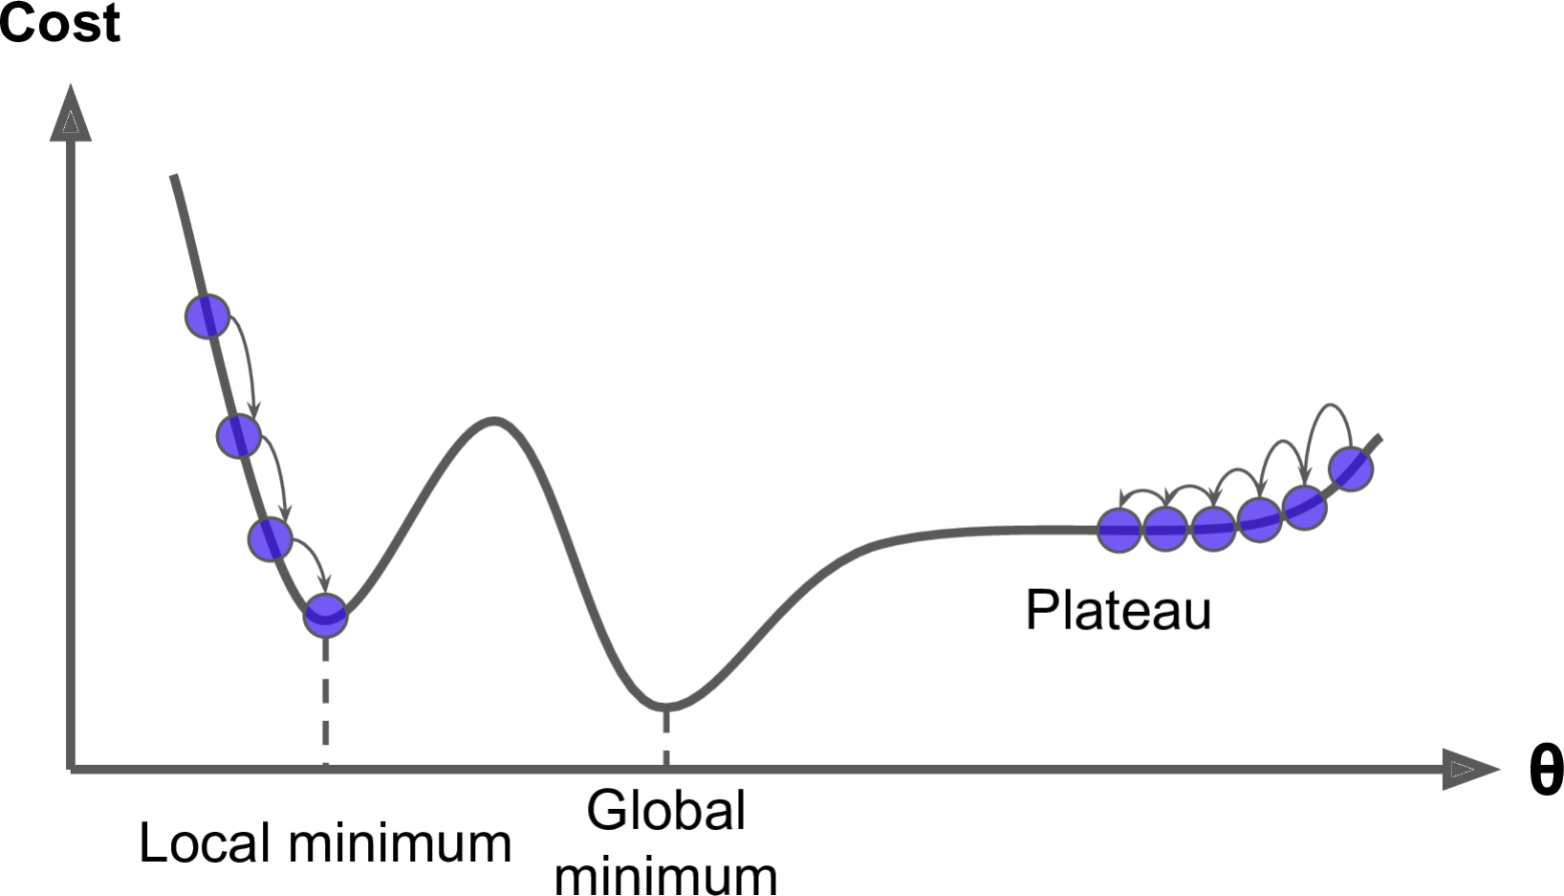


Problems of Gradient descent
1. Local minima

Slide 4
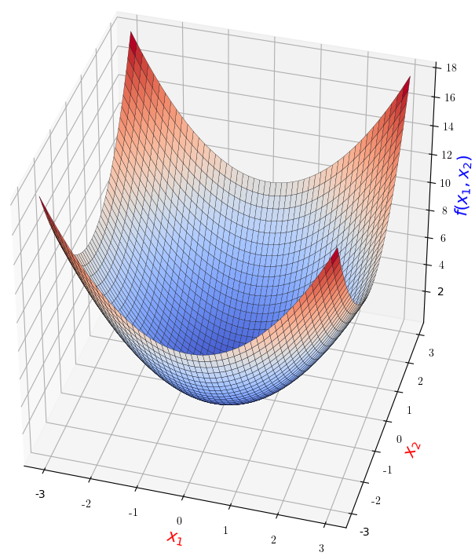
Problems of Gradient descent
2. Feature scales
Similar scales

Slide 5
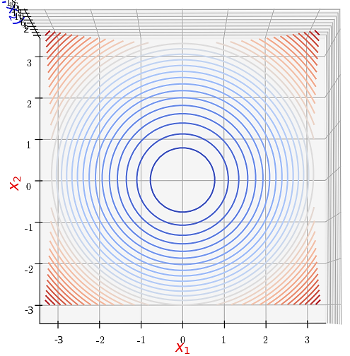


Problems of Gradient descent
2. Feature scales
Similar scales
(contour plot)

Slide 6
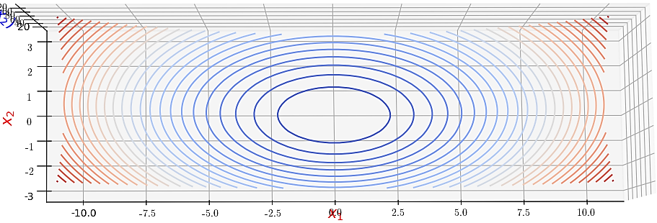
Problems of Gradient descent
2. Feature scales
(Very) Different scales
(contour plot)

Slide 7

2. Stochastic gradient descent

Slide 8
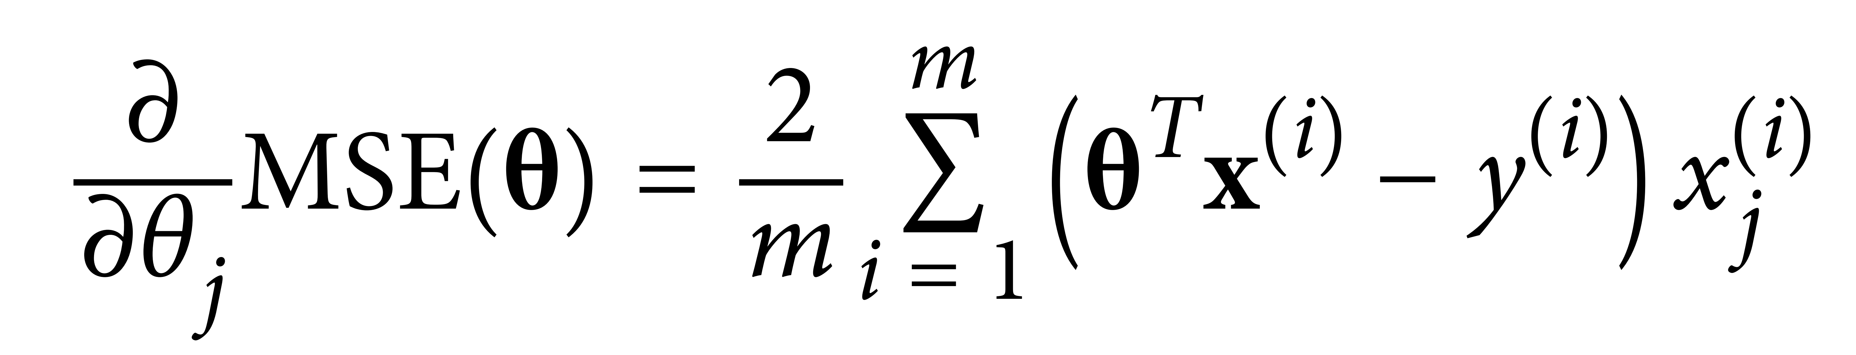



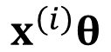

Stochastic gradient descent (SGD)
Batch GB is terribly slow on very large training sets:
SGD uses only one (random) sample to compute gradients:
$$x^{\left(ⅈ\right)}θ$$
$$x^{\left(ⅈ\right)}θ$$

Slide 9



Stochastic gradient descent (SGD)
SGD:
much faster than BGD.
uses much less memory than BGD:

Slide 10
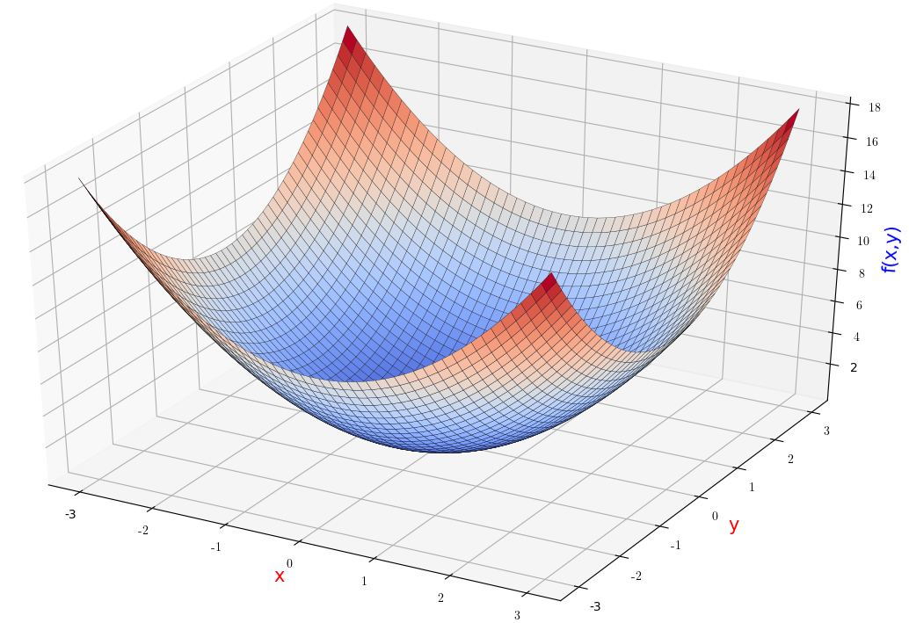





Properties of SGD
1. Runs “randomly”: not decreases cost function on every iteration.
➔ Benefit:

Slide 11
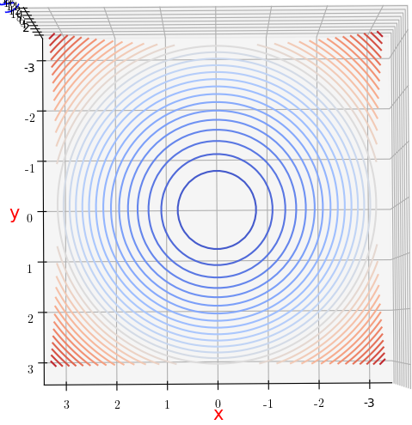




Properties of SGD
2. When at (close to) the minimum: continue to bounce around
➔ Solution:

Slide 12



Implementation of SGD
If the learning rate is reduced too quickly:
If the learning rate is reduced too slowly:
To decrease learning rate properly, we create a function called learning schedule.
>> Go to code.

Slide 13
3. Mini-batch gradient descent

Slide 14


Computation of gradients in
Batch GD:
Stochastic GD:
$$x^{\left(ⅈ\right)}θ$$
$$x^{\left(ⅈ\right)}θ$$

Slide 15










Computation of gradients in
Mini-batch GD:
➔ Less “random moves” than with SGD:
$$x^{\left(ⅈ\right)}θ$$

Slide 16
Implementation by Scikit-Learn
>> Go to code

Slide 17
Comparison of LR training algorithms
Algorithm | Large m | Large n | Scaling required | Scikit-Learn
Normal Eq. | Fast | Slow | No | LinearRegresion*
Batch GD | Slow | Fast | Yes | n/a
Stochastic GD | Fast | Fast | Yes | SGDRegressor
Mini-batch GD | Fast | Fast | Yes | n/a
* The implementation of Normal Eq. in LinearRegresion uses Singular Value Decomposition (SVD) method that works with singular matrices.
Credit: (Gerón, 2019)

Slide 18







Train Polynomial Regression (PR) models

Slide 19

Hypothesis function of PR

Slide 20


Hypothesis function of PR

Slide 21
To train PR models
1. Add “new” features (high-order features)
2. Run Linear regression training algorithms (e.g., Normal Eq., Gradient descent).
>> Go to code.

Slide 22
UNDERFITTING AND OVERFITTING

Slide 23


Methods to identify underfitting/overfitting
1. Use cross-validation:
Underfitting models :
Overfitting model:
2. Use learning curves: plot performance against training set size (or the training iteration).
➔
>> Go to code.

Slide 24
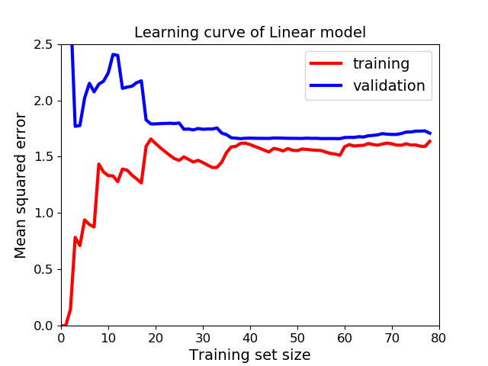




Underfitting or overfitting?
Learning curve on training data:
With few instances:
With more data:
Learning curve on validation data:
Models trained on few instances:
More training examples:
➔

Slide 25
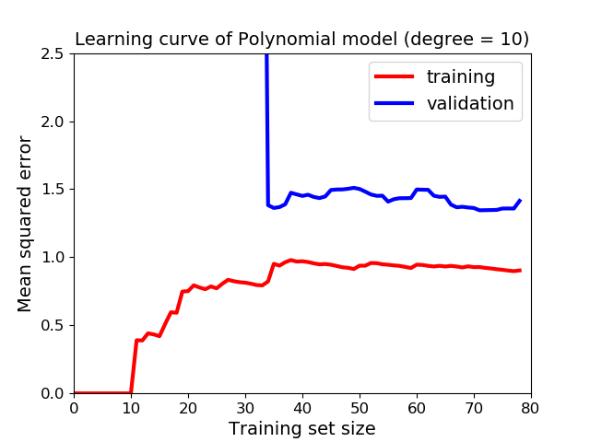



Underfitting or overfitting?
Compared to the learning curve of linear model:
Both errors on training and validation data:
Gap b/w curves:
➔

Slide 26
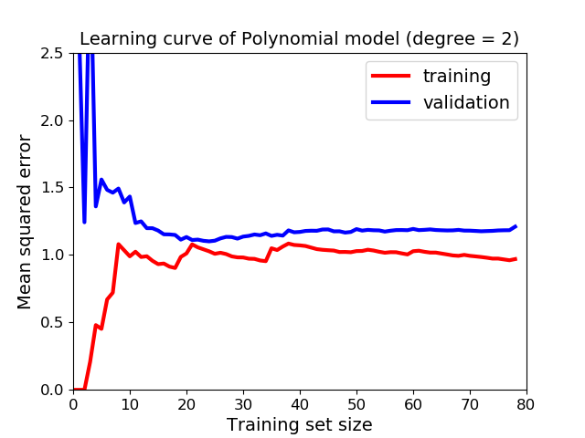

Underfitting or overfitting?
Compared to the learning curve of polynomial model (degree 10):
Both errors on training and validation data:
➔

Slide 27
Types of errors in machine learning

Slide 28









3 types of errors in machine learning
Bias* error: wrong assumption
Variance error: too sensitive model
Irreducible errors: noisy data.
* Not to be confused with bias term in the hypothesis function.

Slide 29



















To overcome these errors
Bias error:
Variance error:
Irreducible errors:

Slide 30
REGULARIZATION

Slide 31
To overcome overfitting
Add more data
Use simpler models
Do regularization
Early stopping

Slide 32



Idea
Use a complex model:
Constrain the model:
3 regularization methods:
Ridge regression
Lasso regression
Elastic net

Slide 33
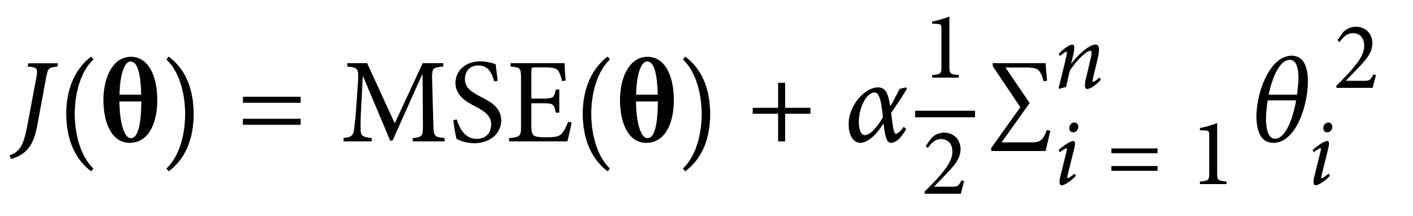



Ridge regression
Cost function of Ridge regression :

Slide 34


Ridge regression
When weights are small:

Slide 35

Ridge regression
Notes:
Cost function for training can be different from the performance measure of the model.
Feature scaling is important for regularized models to work properly.
>> Go to code.

